Slide 1
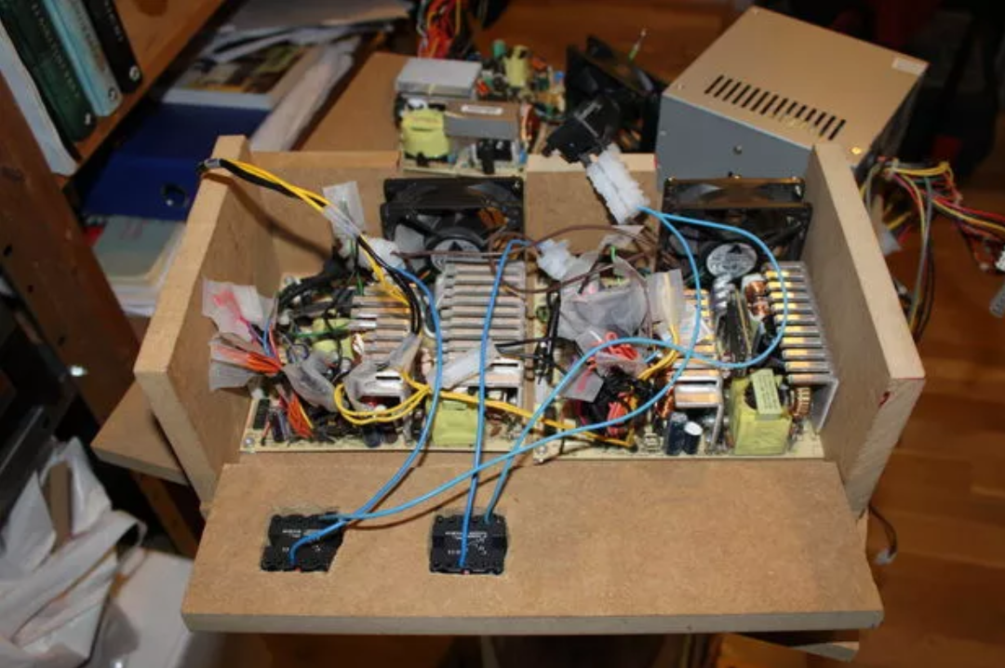
Power Supplies 101 DC-DC Converters
10-Feb-2018

Slide 2
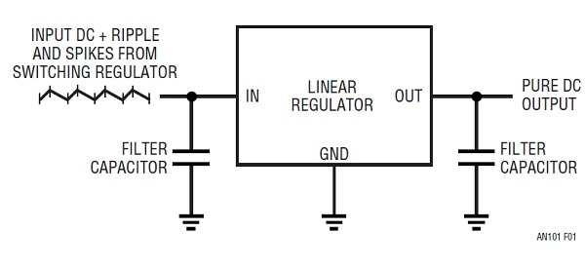
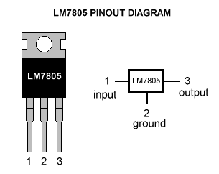
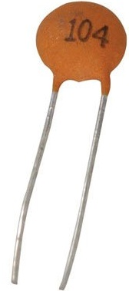
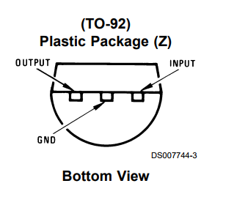
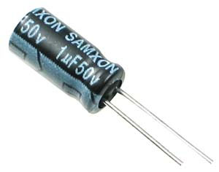
Using Fixed Voltage Linear Regulators
V_{IN}
V_{OUT}
0.1uF ceramic caps are good, easy choices
Try a 1uF electrolytic, too, watch polarity!

Slide 3
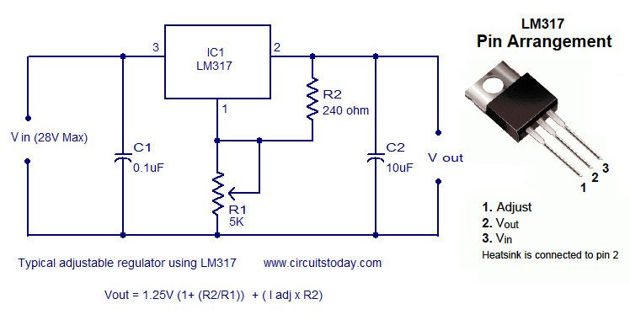
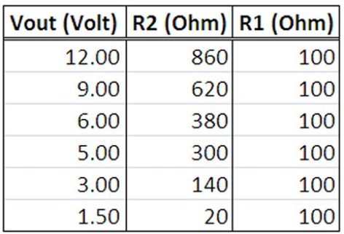
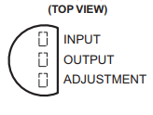
Using the LM317 Adjustable Regulator

Slide 4
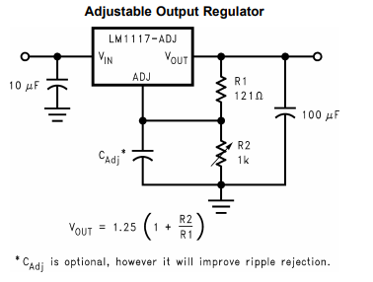
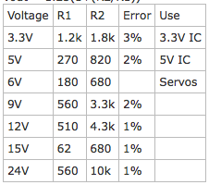

Using the LM1117 Adjustable Regulator

Slide 5
Zener Supply
12V
R1
I_{BIAS}
V_{OUT=}V_{ZENER}
I_{LOAD}

Slide 6
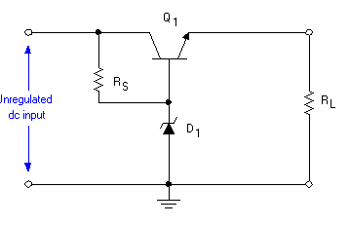
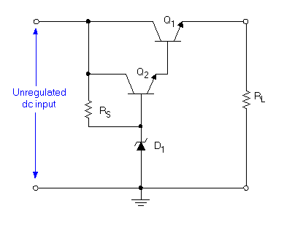
Zener with Transistor Supplies

Slide 7
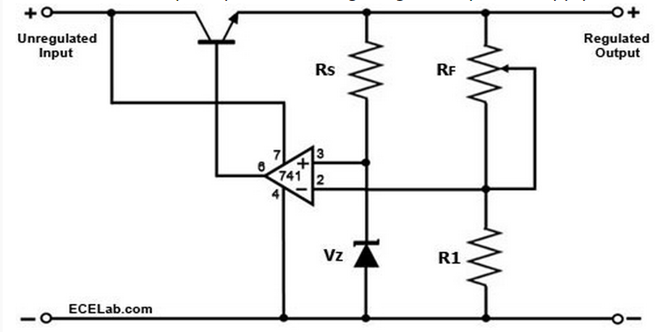
Discrete Linear Regulator

